Slide 1

Visión por Computador
Domingo Mery, Daniel Sebastián Gaete
(con videos de Avishek Biswas)
Departamento de Ciencia de la Computación
Escuela de Ingeniería
Universidad Católica de Chile
Stable Diffusion

Slide 2
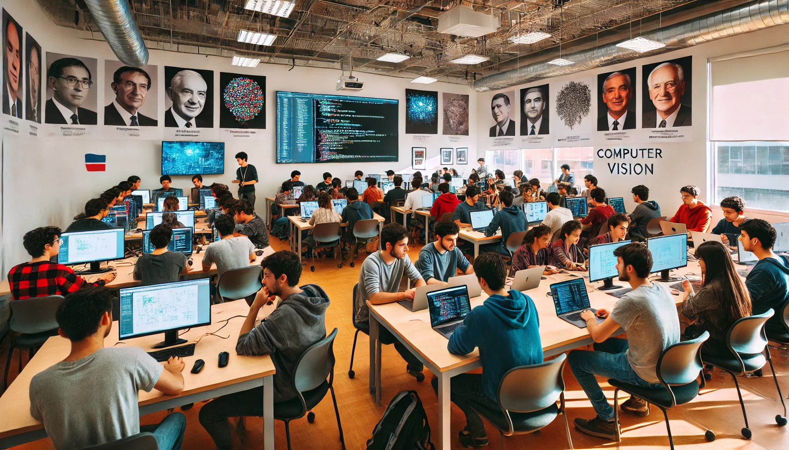

Generate an image of 30 university students from a class of a computer vision course in Chile

Slide 3
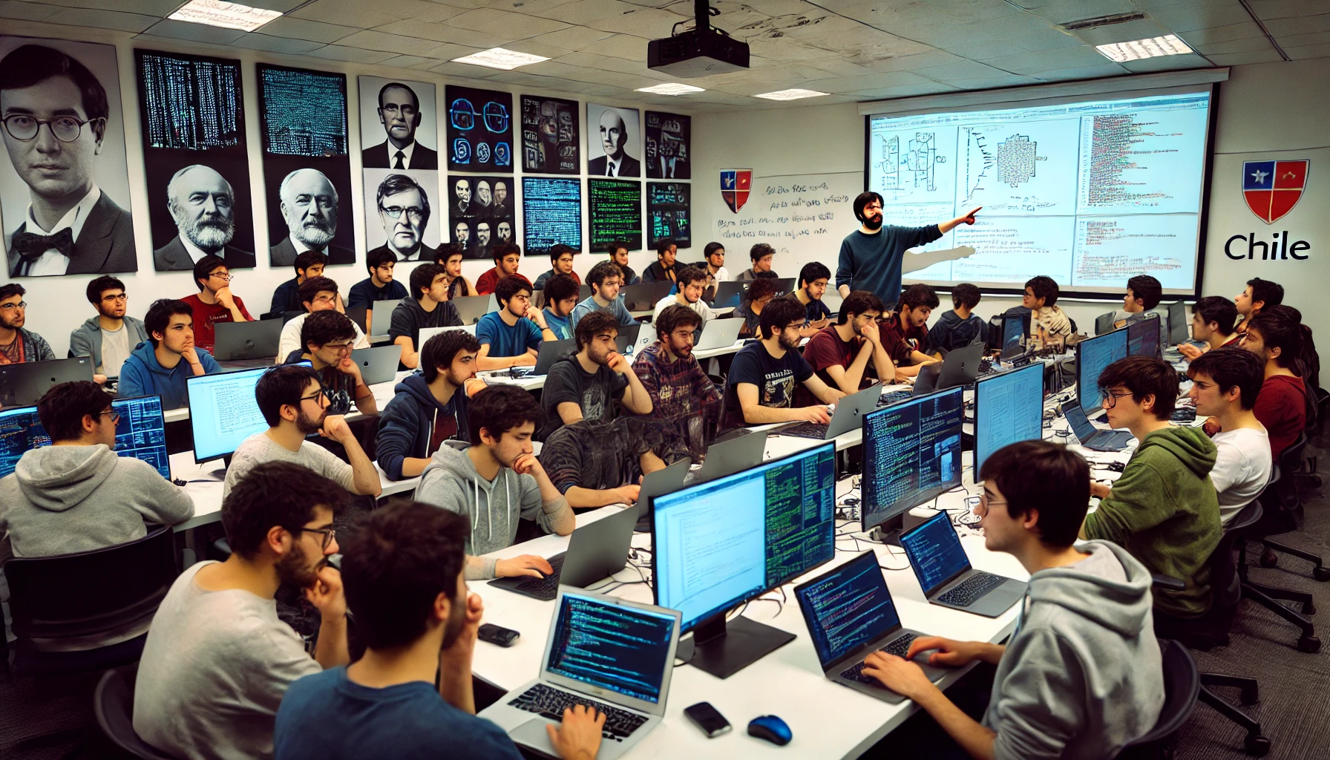
add a teacher

Slide 4
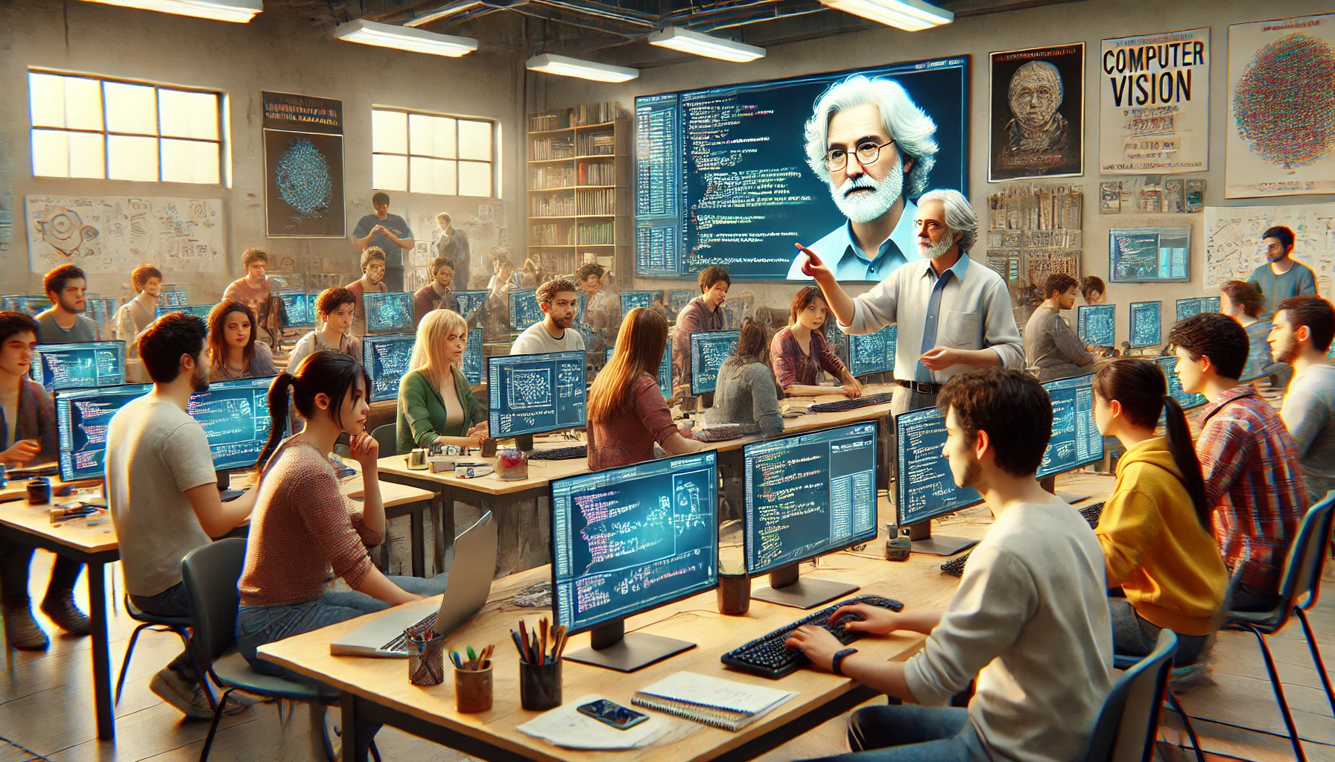
change the teacher for one with more experience (50 years old or older) and also include female students

Slide 5
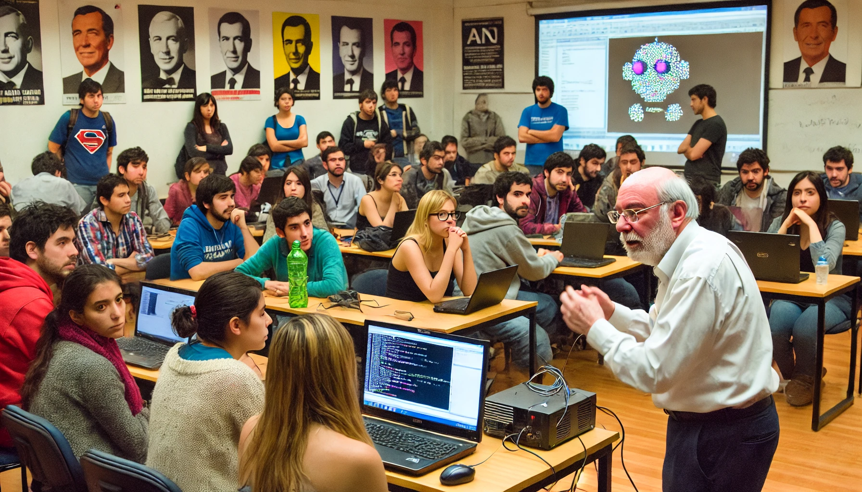
change the teacher for one with less hair and a shorter beard

Slide 6
The images were generated by OpenAI's DALL-E 2

Slide 7
How to generate images from text?

Slide 8


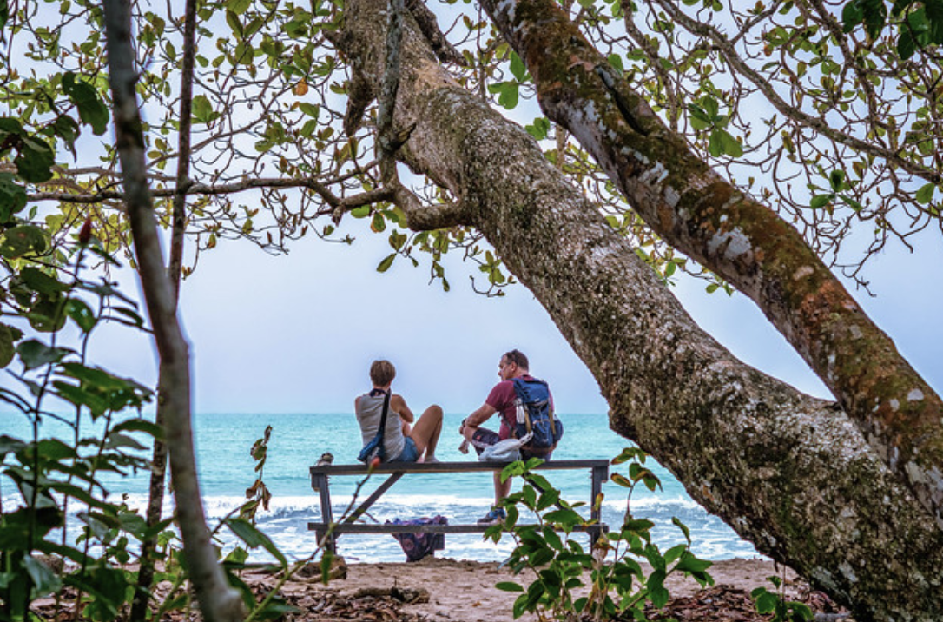
Key Idea of CLIP
Two people relax at a beach under a tree, enjoying a serene ocean view.
EMBEDDING 1
(must be)
VERY
SIMILAR
→ HIGH
EMBEDDING 2

Slide 9

Key Idea of Text to Image Generation
Two people relax at a beach under a tree, enjoying a serene ocean view.
EMBEDDING 1
(must be)
VERY
SIMILAR
→ HIGH
EMBEDDING 2

Slide 10
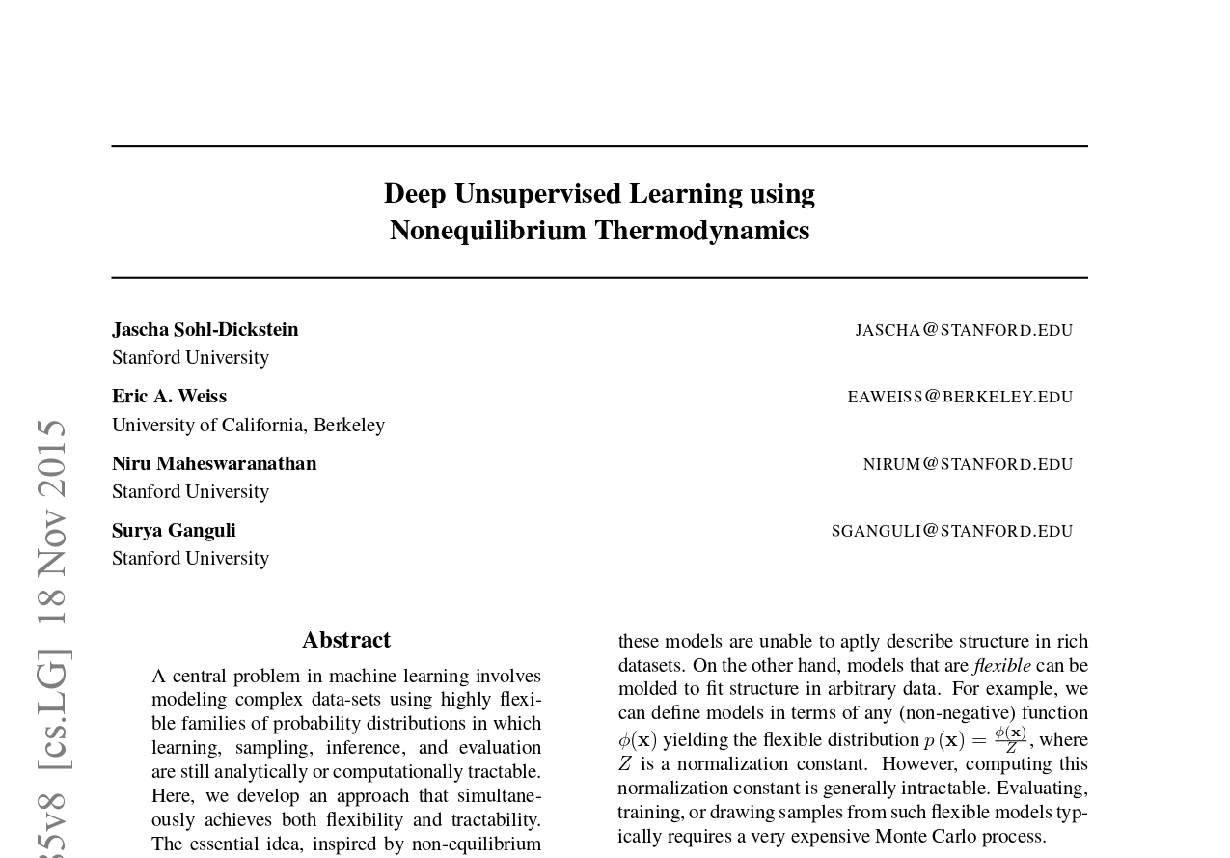

Slide 11
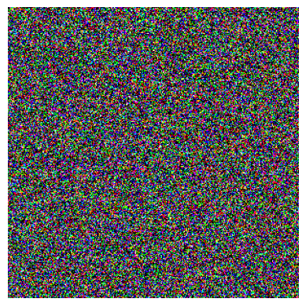
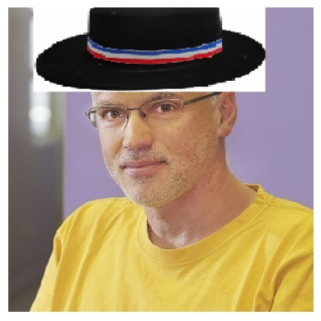
Image Generation – How to generate an image from noise?

Slide 12
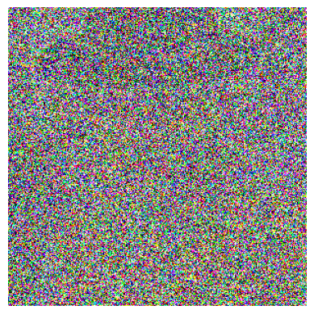
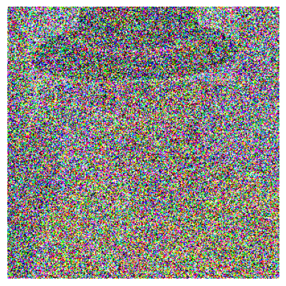
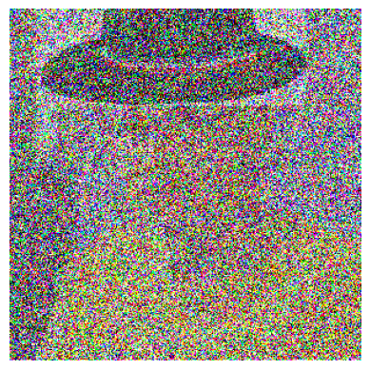
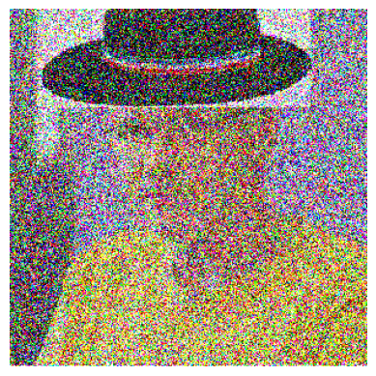
Image Generation – From Image to Noise

Slide 13
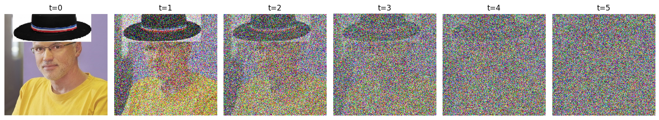
Image Generation – Idea

Slide 14
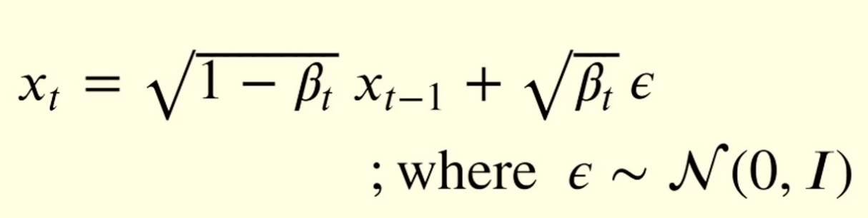

Image Generation – Idea
x₀
x₁
x₂
x₃
x₄
x₅
noise
Amount of Gaussian noise added at timestep t

Slide 15
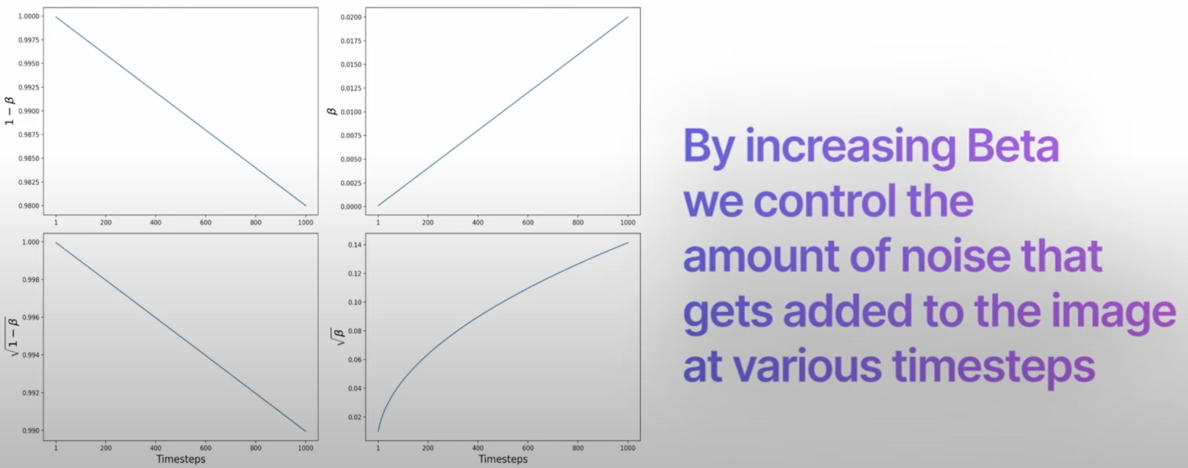
Amount of Gaussian noise added at timestep t

Slide 16
Image Generation – Idea
x₀
x₁
x₂
x₃
x₄
x₅
noise
Amount of Gaussian noise added at timestep t

Slide 17
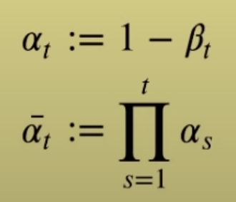

Image Generation – Idea
x₀
x₁
x₂
x₃
x₄
x₅

Slide 18
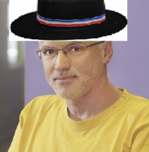
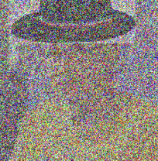
Image Generation – Idea
t = 2

Slide 19
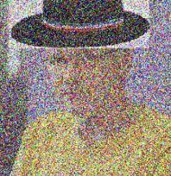
Image Generation – Idea
t = 1

Slide 20

Image Generation – Idea
t = 4

Slide 21
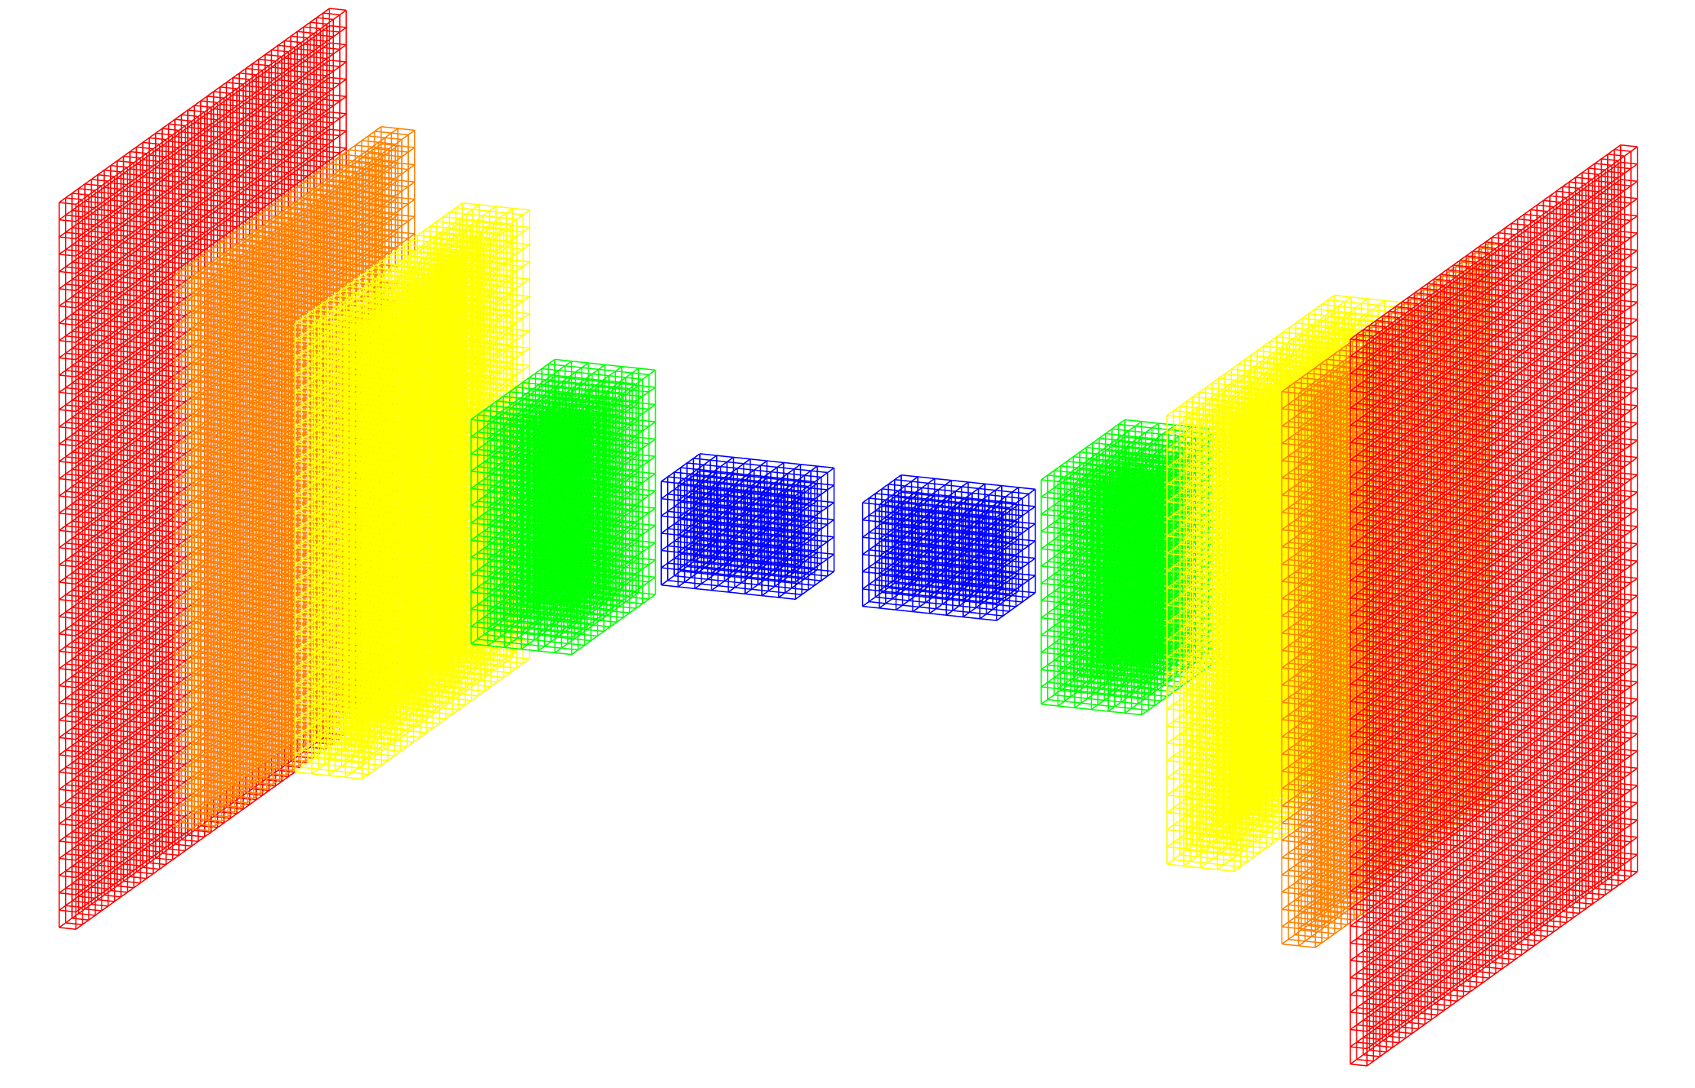
Image Generation – Idea : UNet for noise estimation
Image + noise
noise
original image

Slide 22
Image Generation – Idea : UNet for noise estimation
Image + noise
x_{t}
noise
t
using positional
encoding

Slide 23
Key Aspects

Slide 24
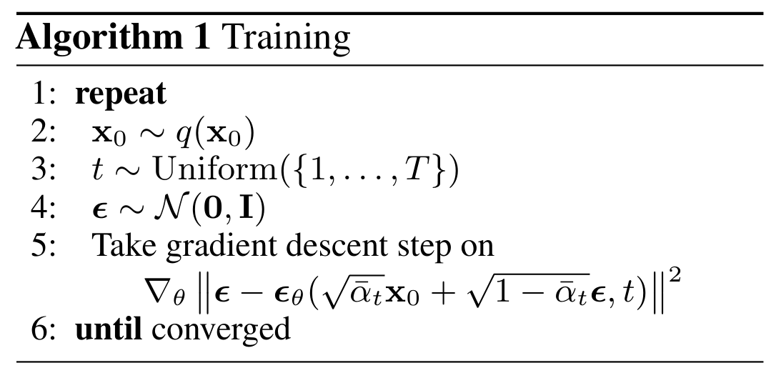
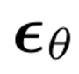
Training
Select image
Choose random t
Gaussian noise
Predict noise
and optimize using gradient descent relative to actual noise t

Slide 25
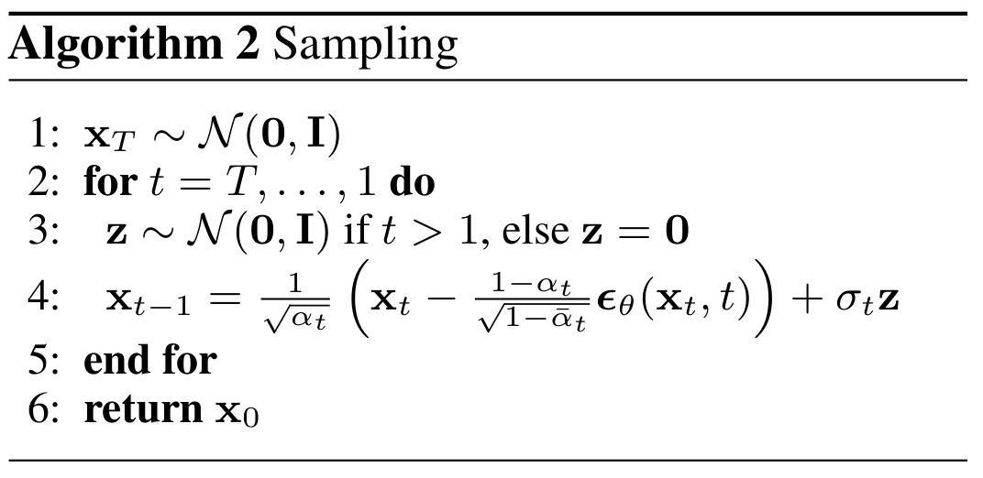

Testing: Reverse diffusion
Random noise
Radom noise for t>1
Predict noise and calculate difference to predict image
Predicted noise using UNet

Slide 26
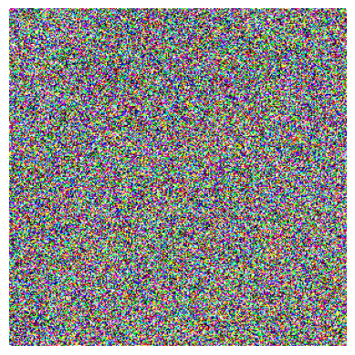
Image Generation – Idea
Example with two iteration.
In practice, we use approx. 1000 iterations

Slide 27
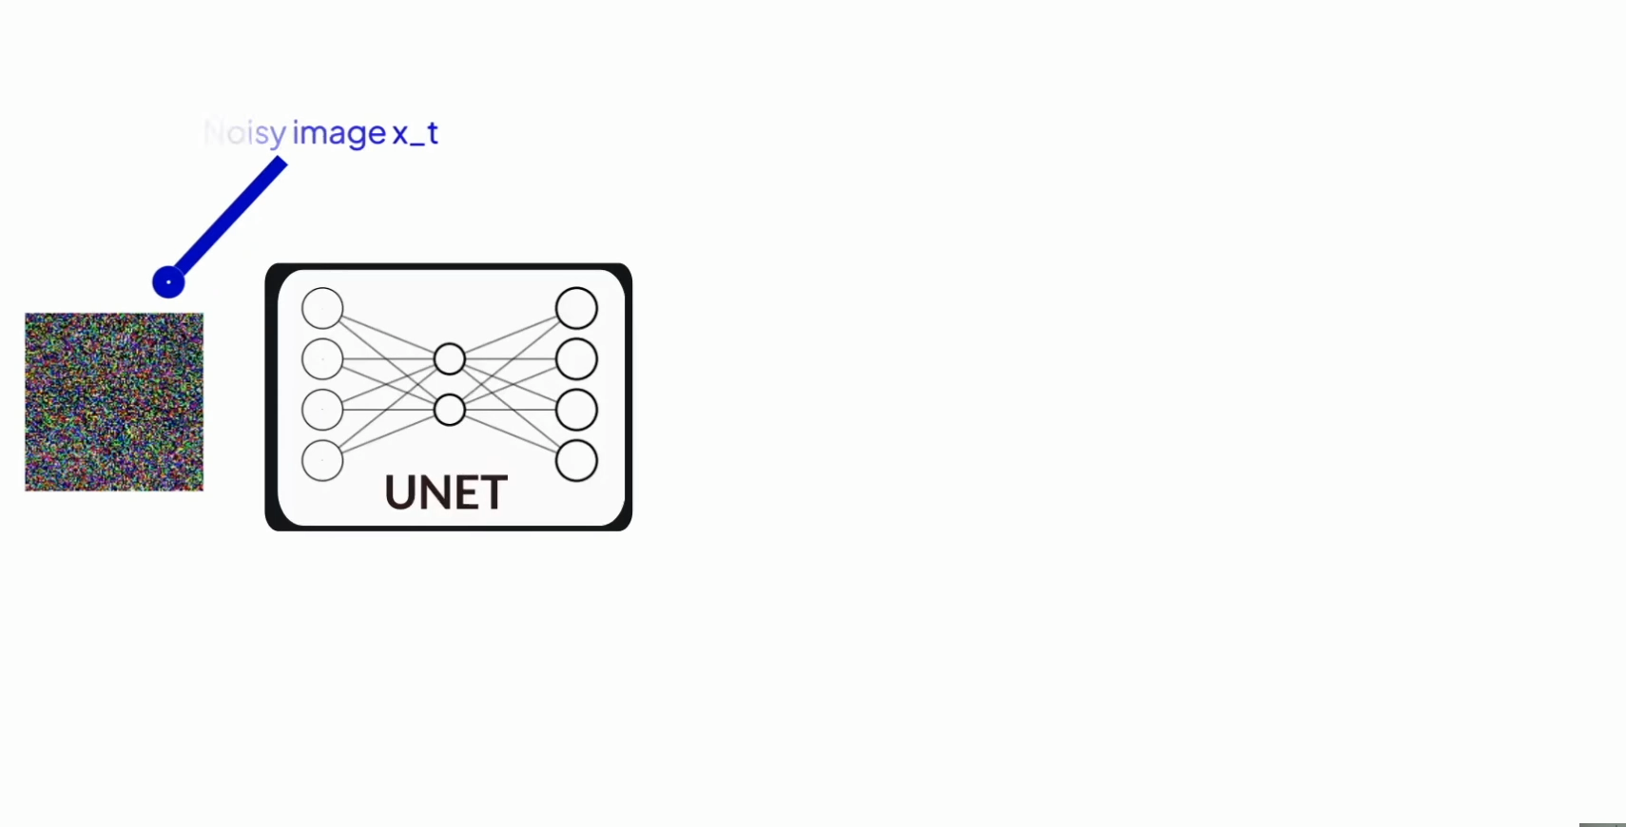
Image Generation – Idea
© https://youtu.be/w8YQcEd77_o

Slide 28
Image Generation – Idea : UNet for noise estimation
Image + noise
x_{t}
noise
t
using positional
encoding

Slide 29
How to include “t” in the Unet?

Slide 30
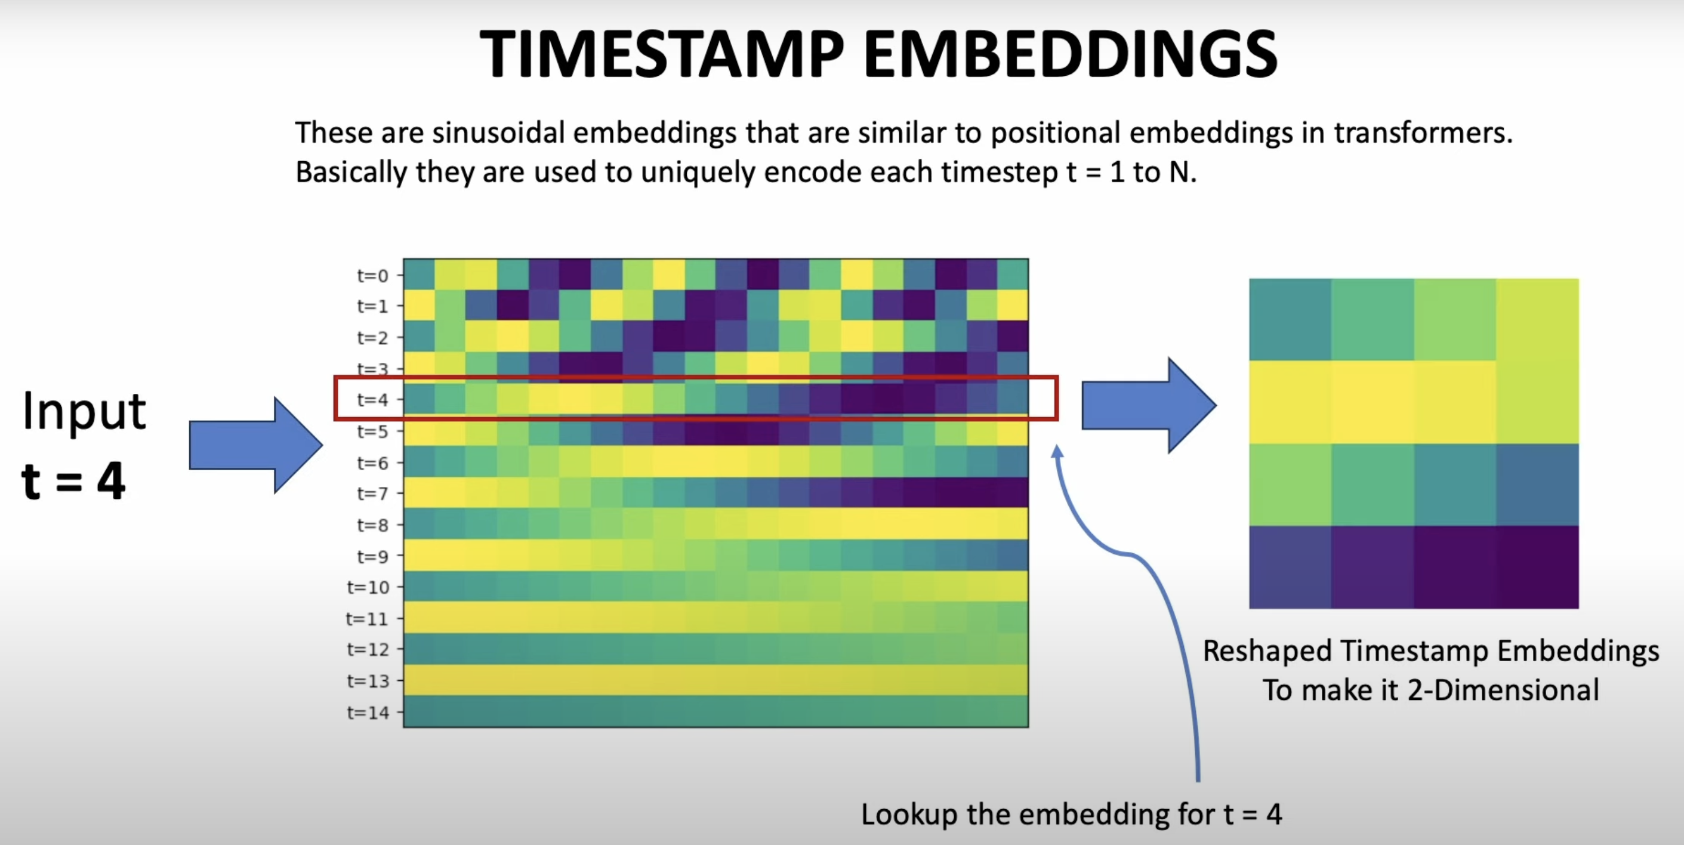
© https://youtu.be/w8YQcEd77_o

Slide 31
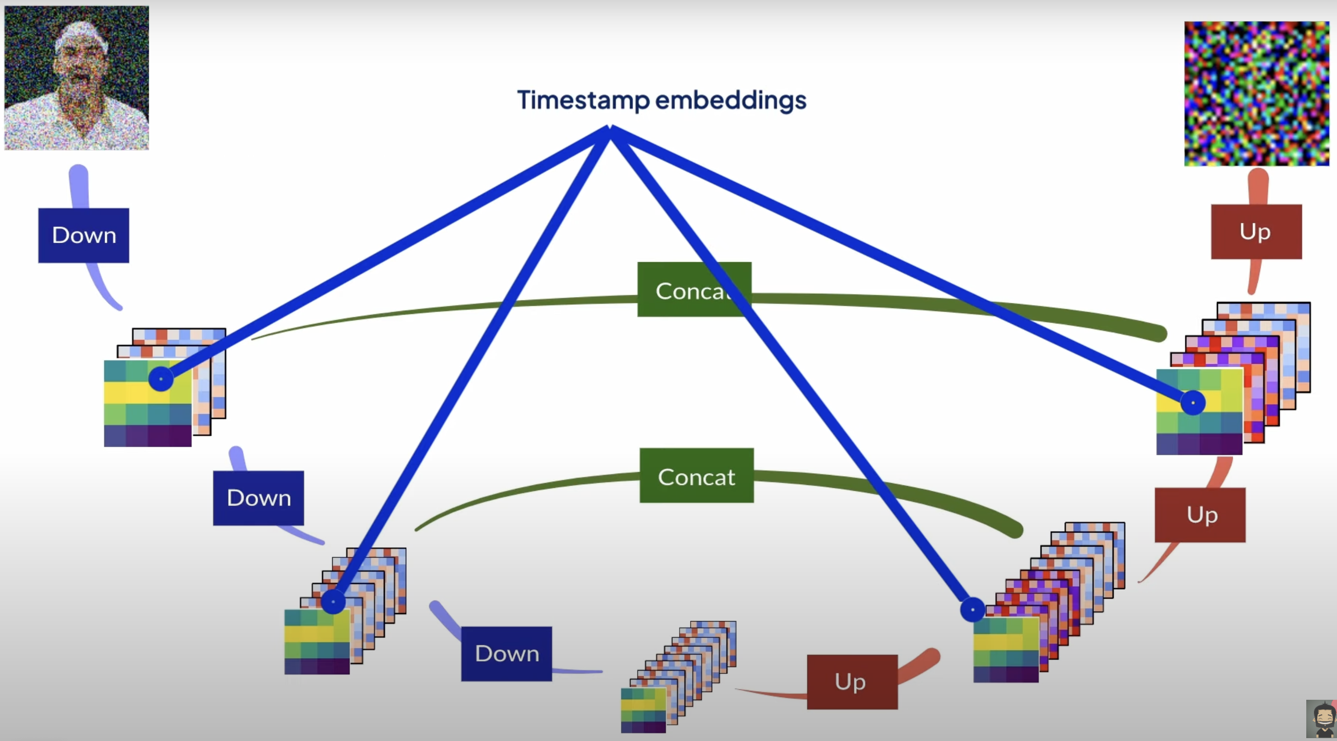

© https://youtu.be/w8YQcEd77_o

Slide 32

How to include text in the UNet to generate images?
EMBEDDING
“Man screaming”
RESHAPE

Slide 33
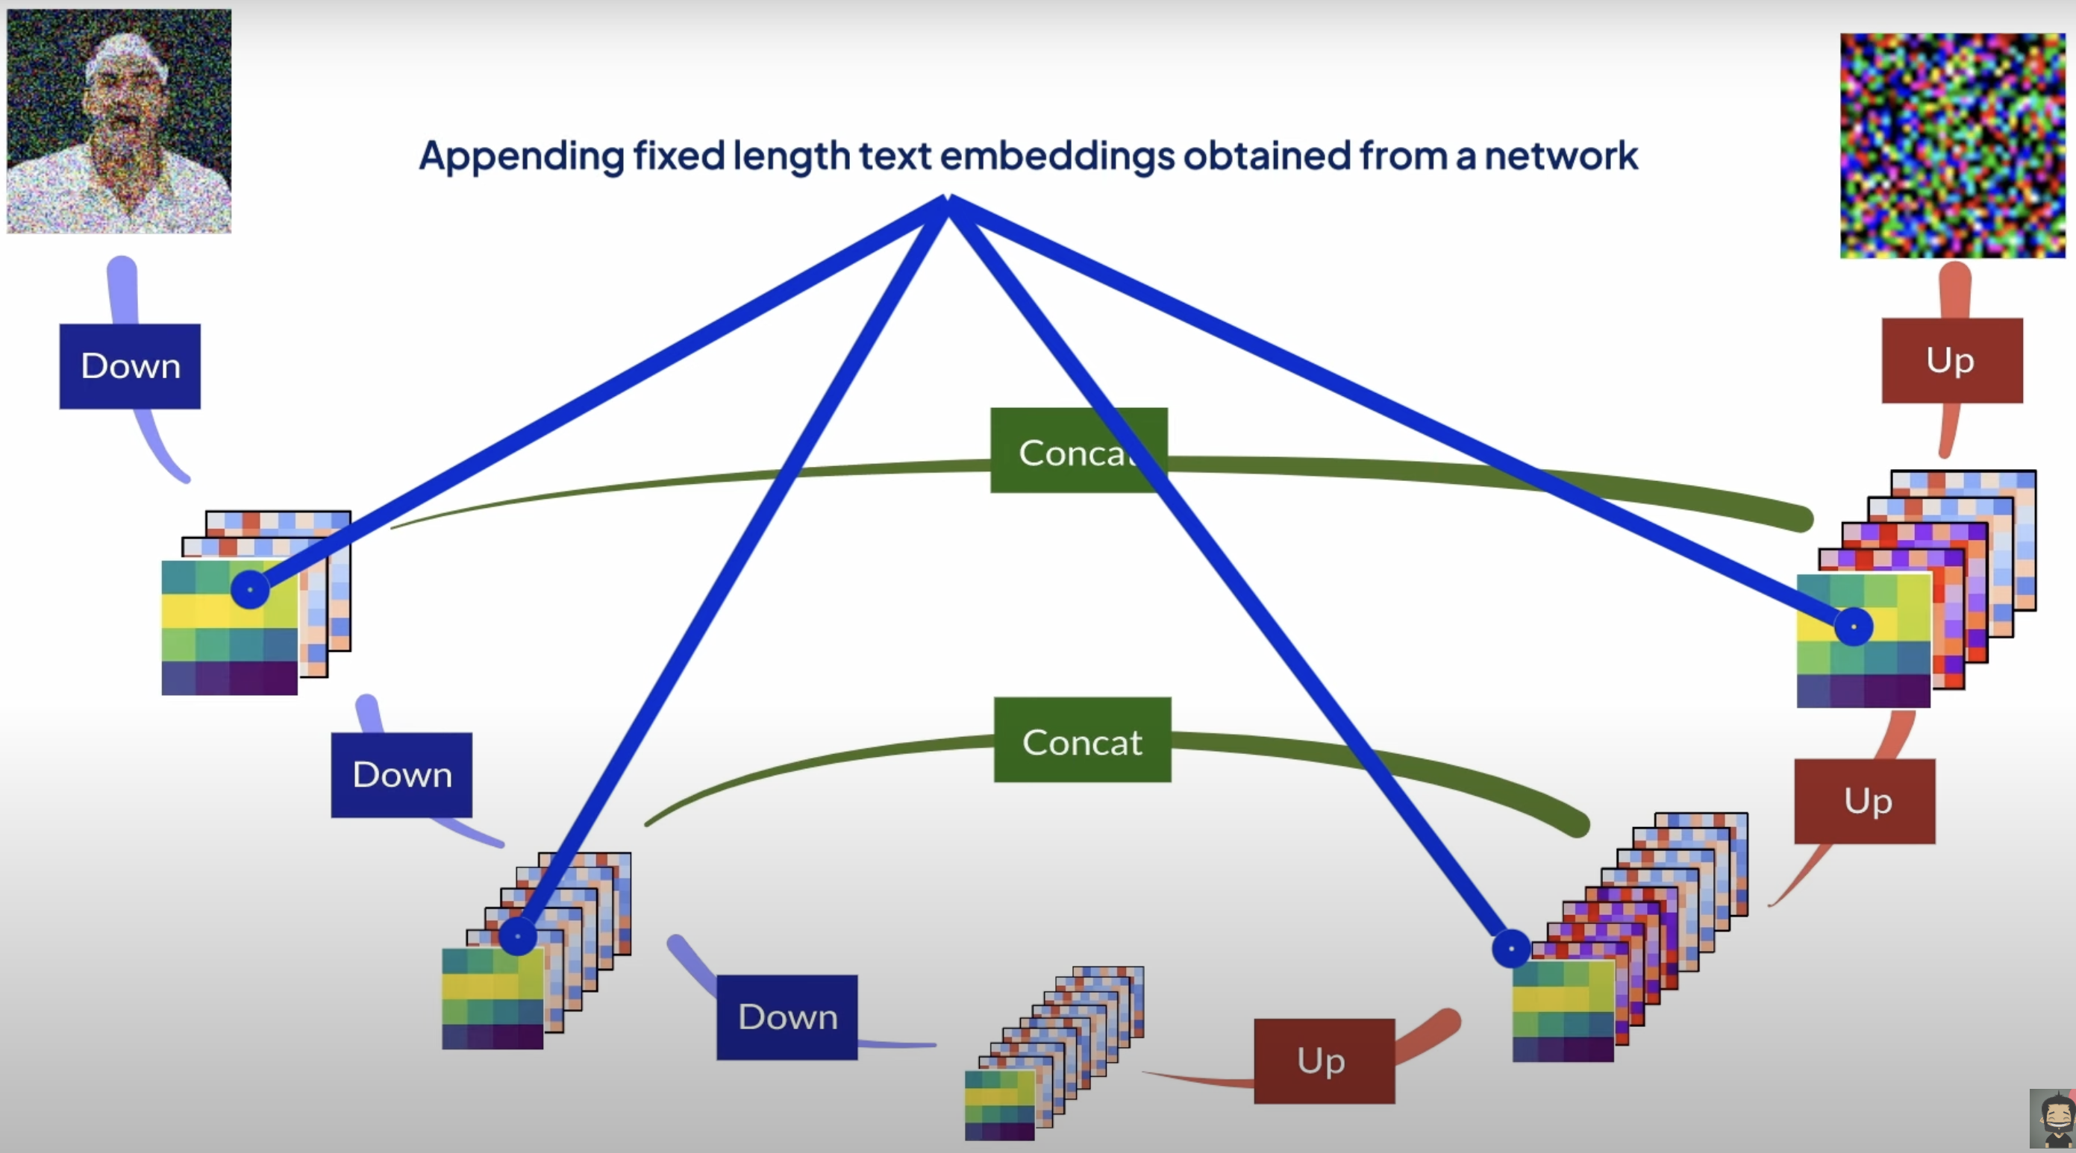
© https://youtu.be/w8YQcEd77_o

Slide 34
How to include text in the Unet to generate images?
A better ideal with Attention

Slide 35
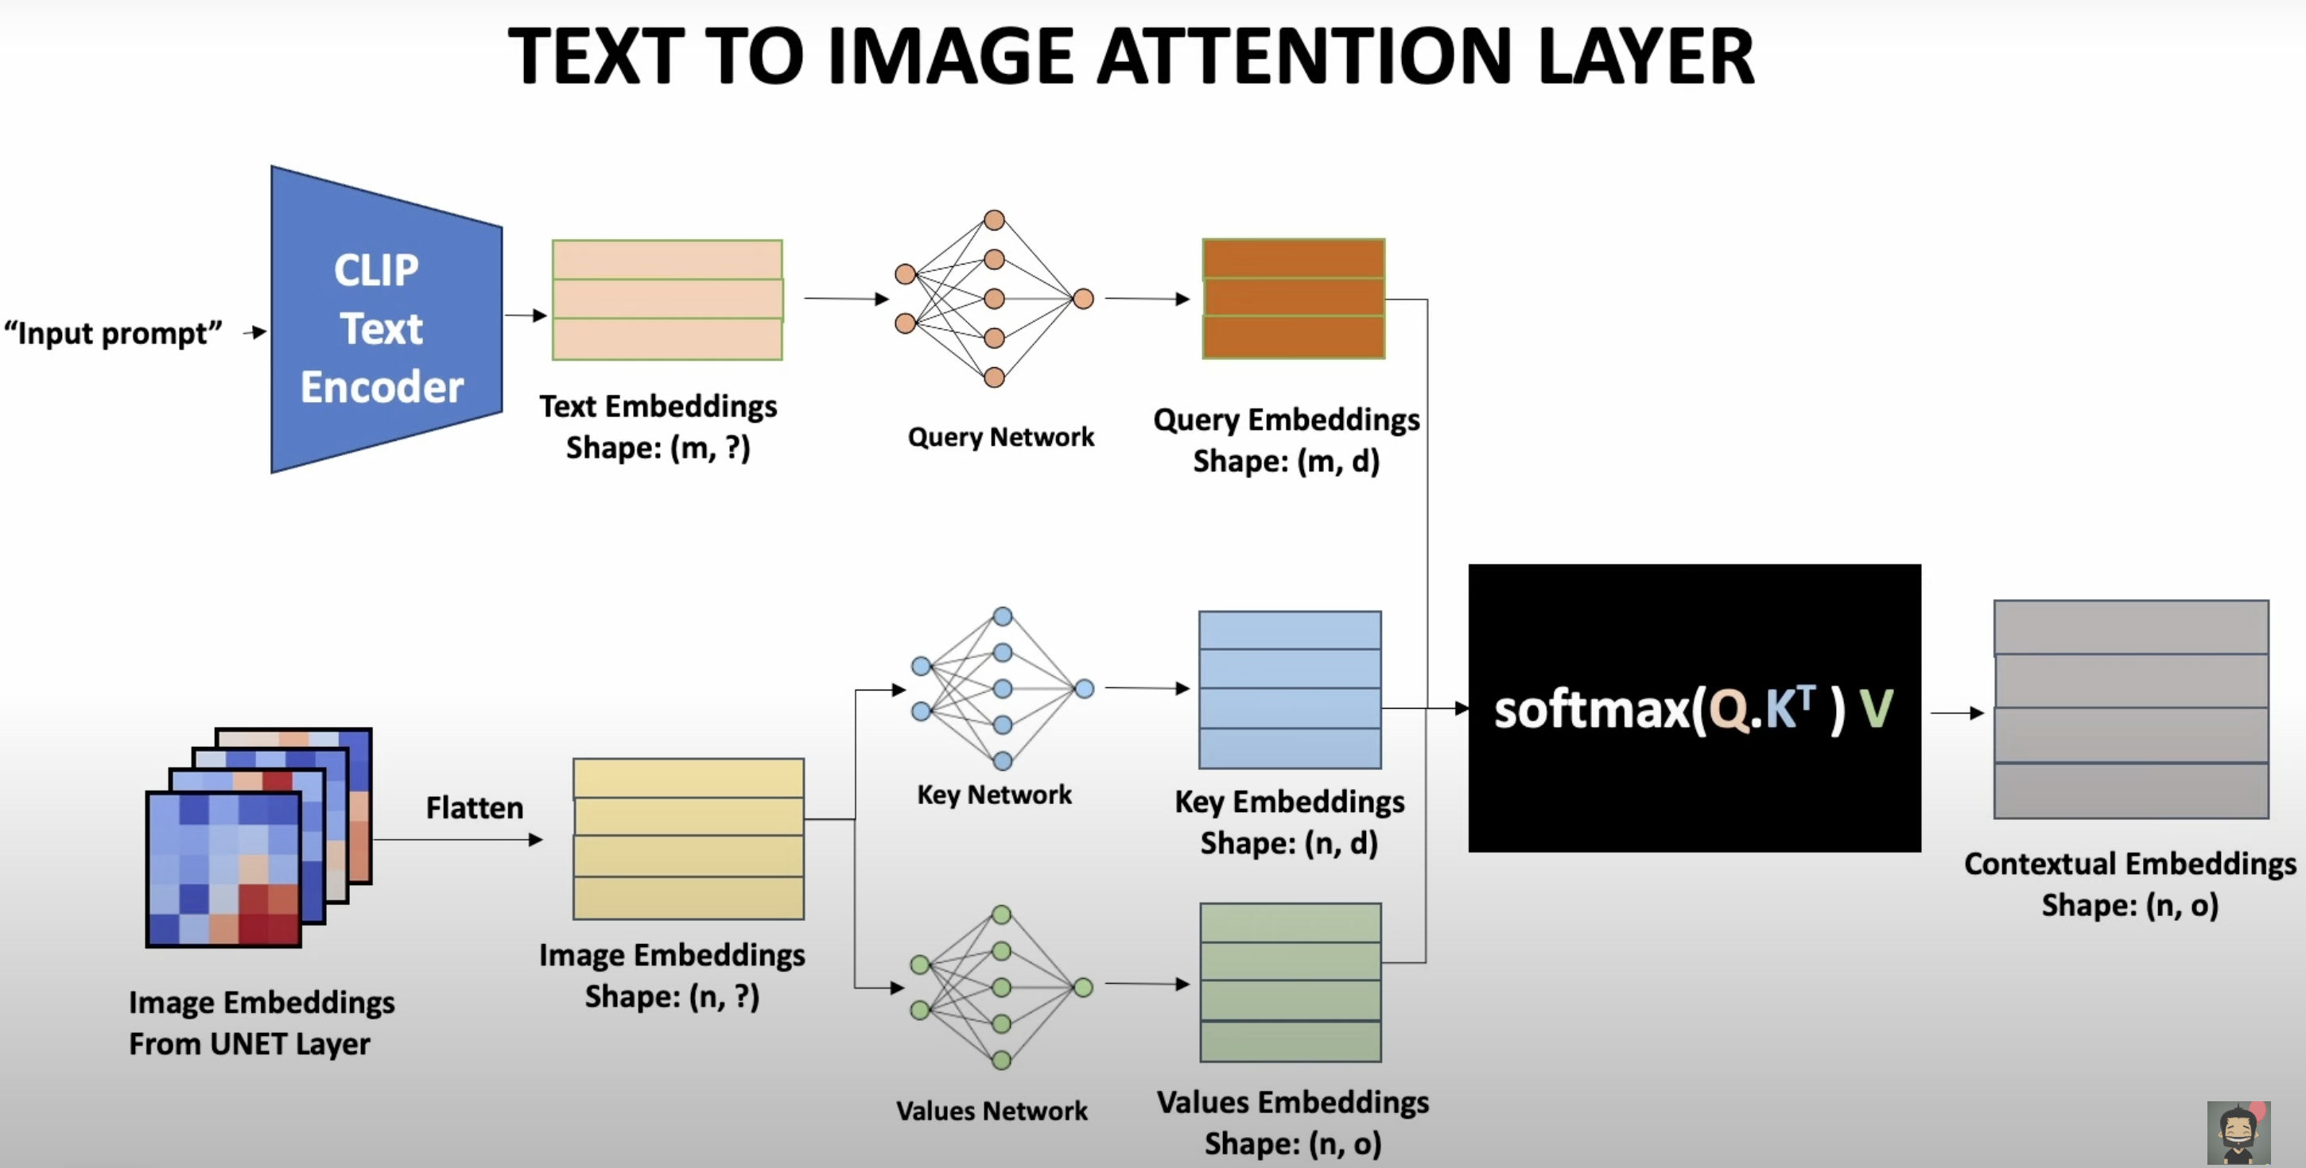
© https://youtu.be/w8YQcEd77_o

Slide 36
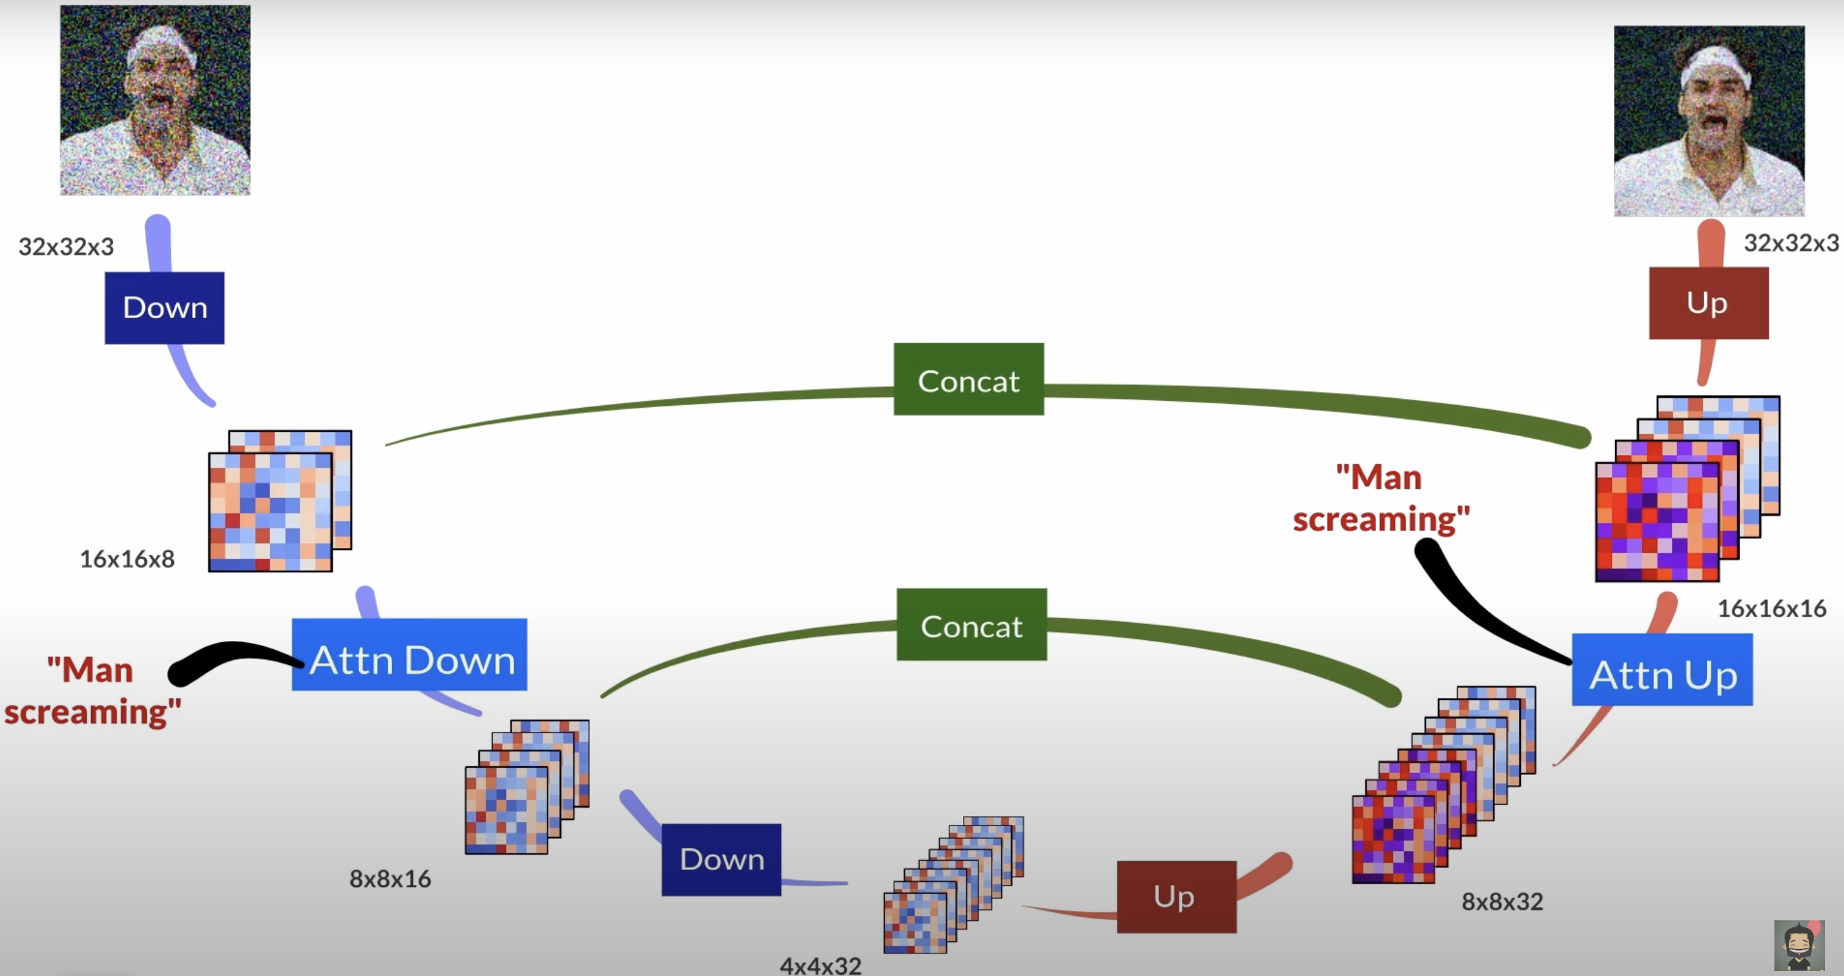
© https://youtu.be/w8YQcEd77_o

Slide 37
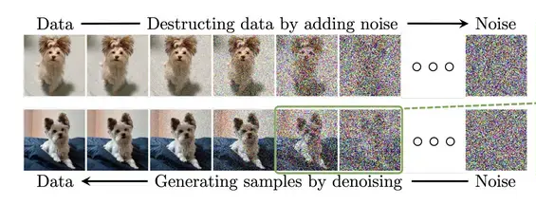
https://www.superannotate.com/blog/diffusion-models

Slide 38
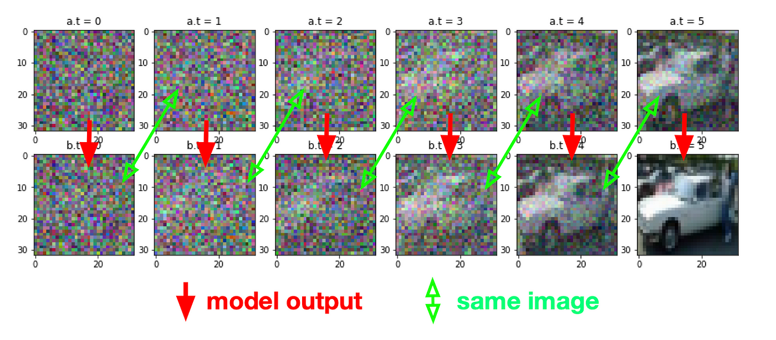
https://tree.rocks/make-diffusion-model-from-scratch-easy-way-to-implement-quick-diffusion-model-e60d18fd0f2e

Slide 39
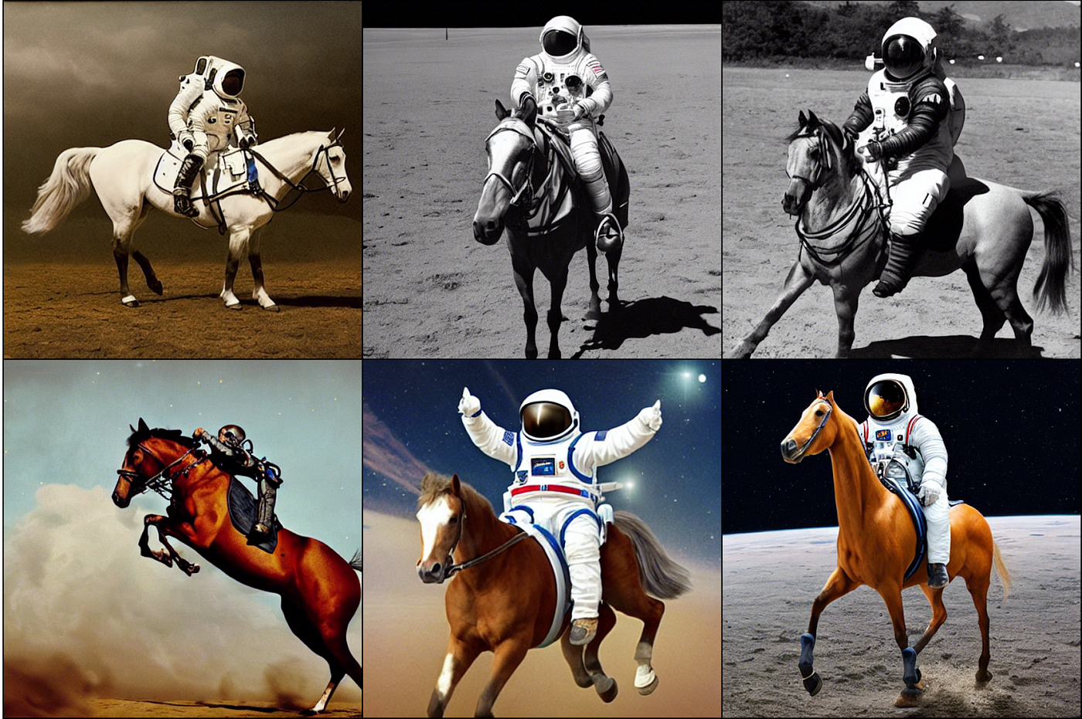
Prompt: a photograph of an astronaut riding a horse
https://klaviyo.tech/trying-to-understand-stable-diffusion-ea55eefca798

Slide 40
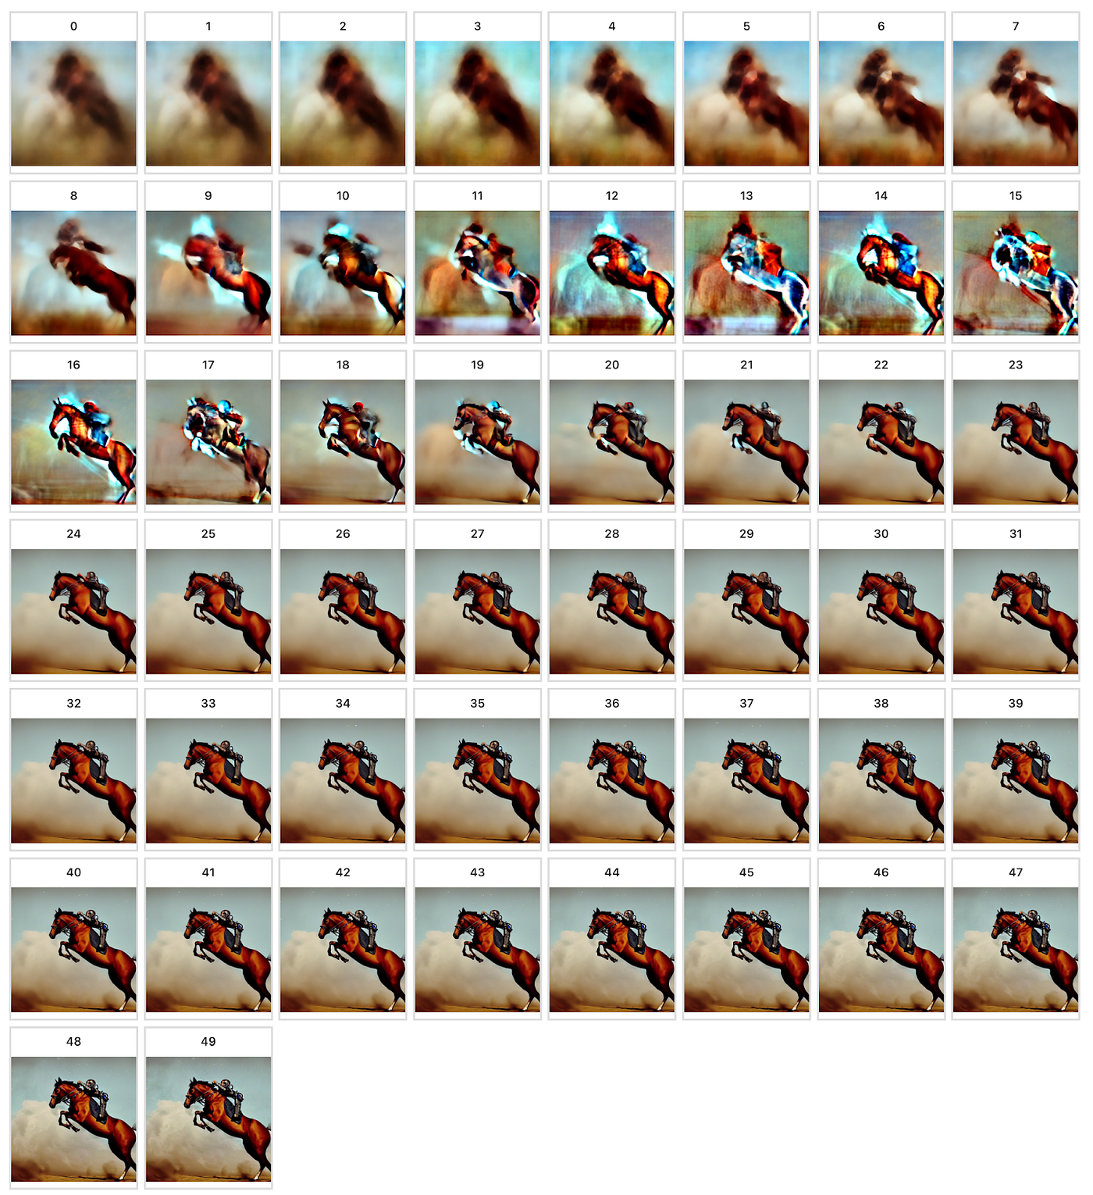
Prompt: a photograph of an astronaut riding a horse

